Slide 1
Tableau Module 14
Data Analytics

Slide 2


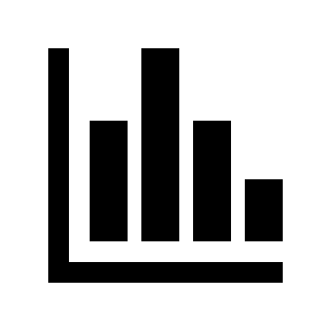























Common Charts
Data Views
Hierarchies
Data Structures
Dashboards
Forecasting
Basic Navigation
Data Stories
Calculations
Advanced
Charts
Certification Springs
Blending
You are here
Done

Slide 3
Module 14 Learning Outcomes
Understand the value of forecasts
Demonstrate creating forecasts
Demonstrate interpretation of forecasts
Describe forecast limitations

Slide 4
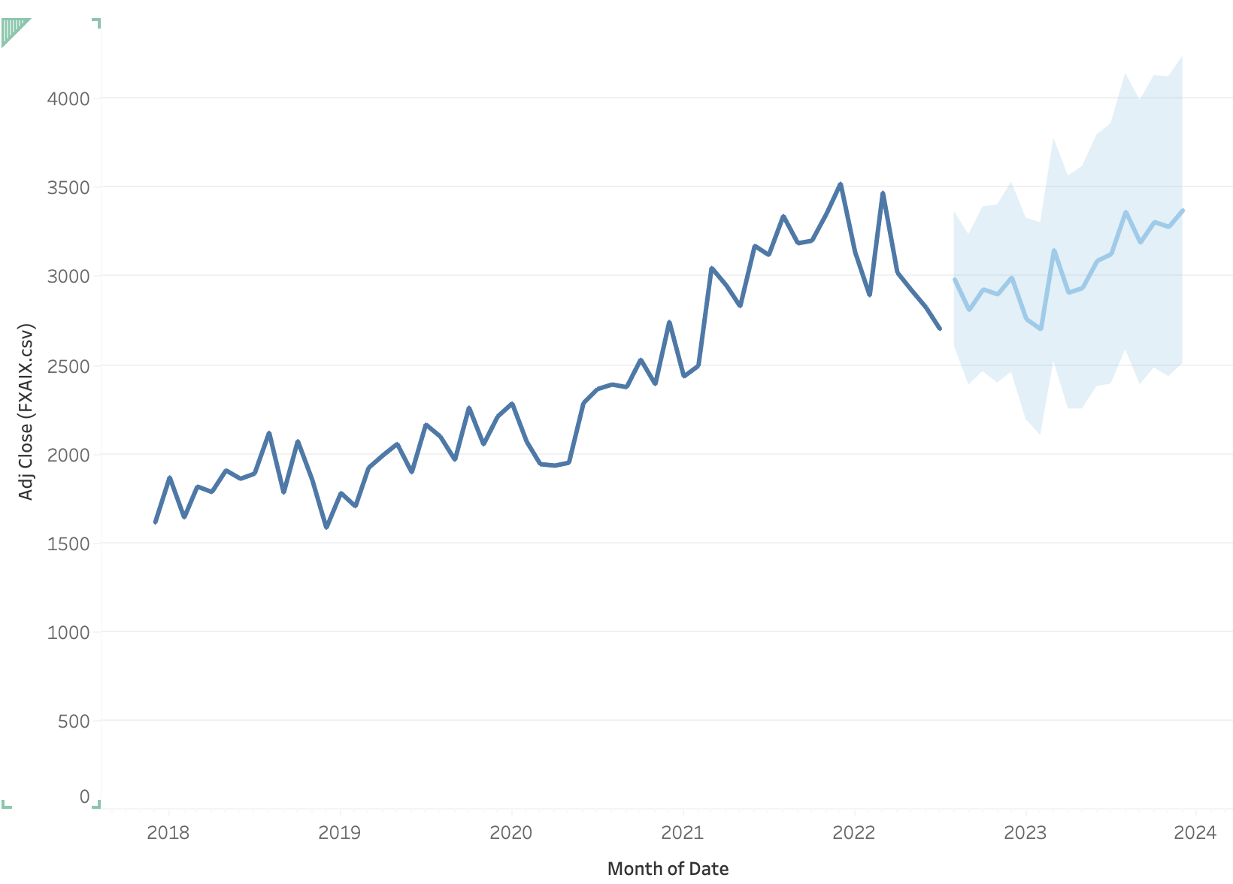
Forecast Fundamentals

Slide 5
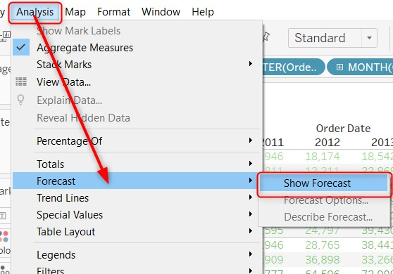
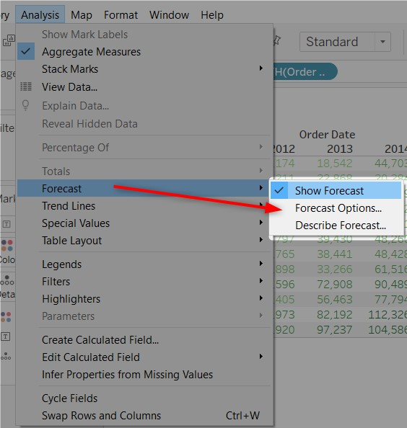
Forecast Models

Slide 6
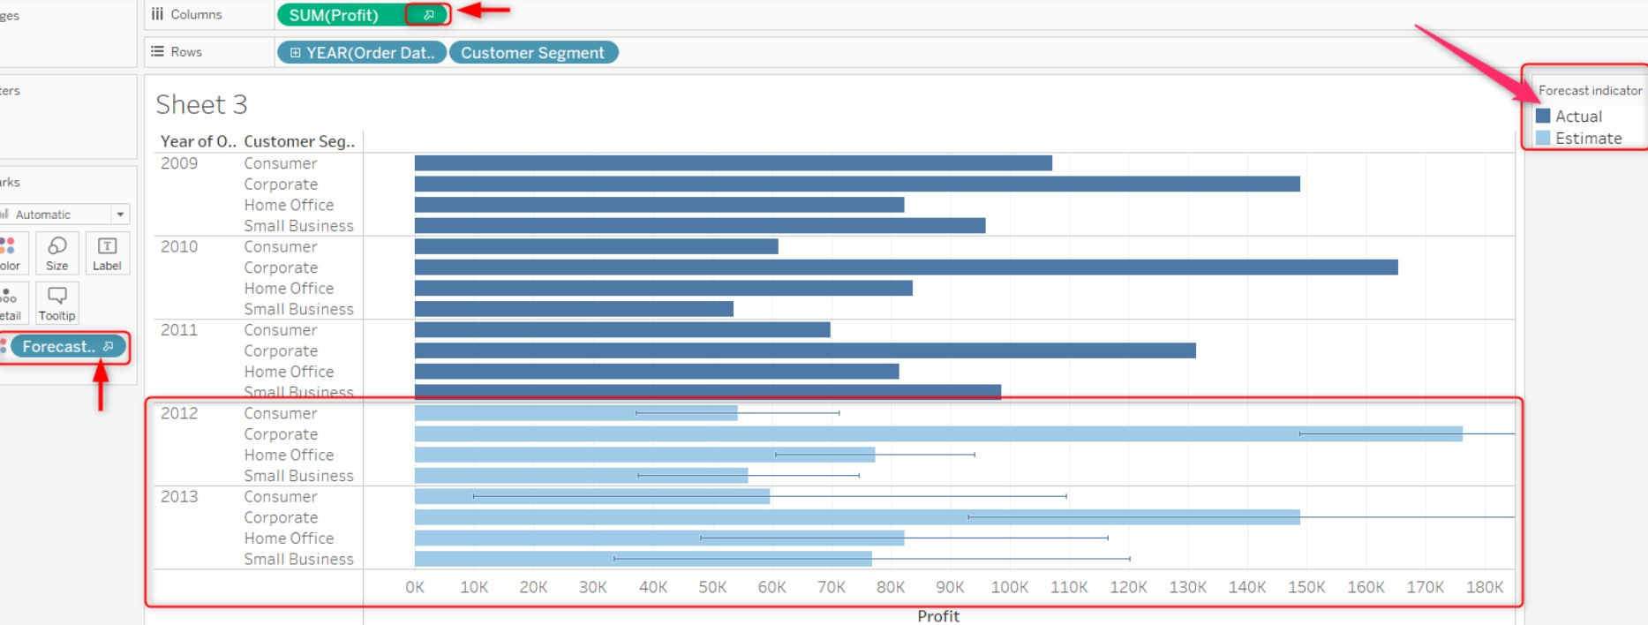
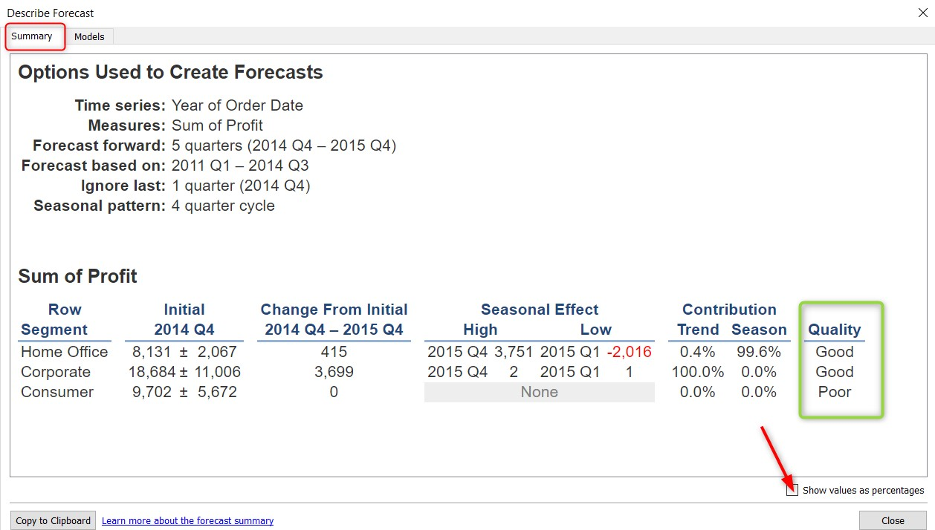
Creating a Forecast

Slide 7
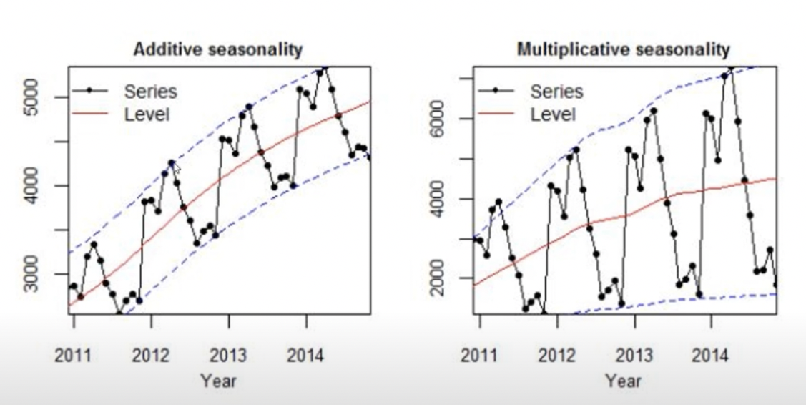
Additive v Multiplicative

Slide 8
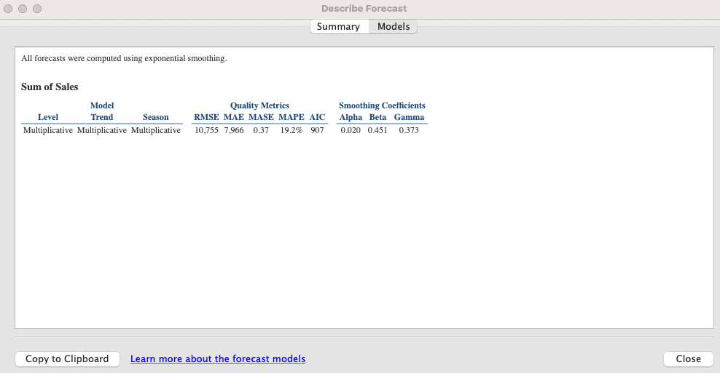
MASE, Mean Absolute Scaled Error
The lower the better
MASE < 0.4 GOOD
MASE < 0.8 OKAY
MASE > 1.0 POOR
The naive model would be better

Slide 9
Forecast Parameters
Actual & Forecast - will show the actual data extended by the forecasted data.
Trend - will show forecast values along with seasonal components removed.
Precision - will show the prediction of the interval distance from the forecast value. Confidence levels configure this.
Precision % - will show precision as percentages of the forecast value.
Quality - will show the quality of the forecast, using a scale of 0 (worst) to 100 (best).
Upper Prediction Interval - is the value above true future values that fall within confidence level percentages. Confidence level percentages are controlled by Prediction Interval settings that are set in the Forecast Options dialog box.
Lower Prediction Interval - will show a 90, 95, or 99 confidence level below the forecasted values. The Prediction Interval Setting sets the default and actual interval.
Indicator - will show the string Actual for rows in the existing worksheet when forecasting was set to inactive. The Estimate is for the rows that were added after forecasting was activated.
None - will not show any forecast data for that measure.

Slide 10
Resolving Errors
Forecasting needs to be done using date fields that can be interpreted continuously. If you use a date field that is not continuous, you will get an error that the date cannot be generated from the fields within the view. To fix this, at least one of the date levels must be a year.
An error that your time series is too short of forecasting means you will need to include more date values. This can happen if you trim or have a misleading forecast.
Forecasts can return an error if Null values are within your date data fields. To fix this, you can exclude the Null values by creating a filter or switching your forecast from months to quarters.
If you have multiple dates in your view, an accurate forecast cannot be computed. For example, a forecast cannot be calculated if you have both a ship date and a return date. To fix this, you will want to include only one date field.
If a date data field in your view is set to months, but you aggregate your forecast by weeks, you can get an error. To fix this, ensure your date field is the same as your forecast aggregate option.
A forecast cannot be computed if you have too many missing values. To fix this, you can select the Fill in missing values with zeros in the Forecast dialog box.
Forecasts are computed using measures and not dimensions. Some measures cannot be interpreted numerically; ensure your data fields fit the forecast requirements.
An error can return if your view has too much data. The limit to forecasting is a maximum of 10,000 rows. To fix this, you can aggregate your data fields, create new calculated fields, filter your data, or change your date to a higher level. For example, from months to years.
Forecasts cannot be computed using table calculations.

